Slide 1

PORT ROYAL, SOUTH CAROLINA

Slide 2
A New Chapter in the Heart of the Lowcountry
London Square is the first major residential community to be developed in the heart of the Village of Port Royal in more than 20 years—a rare opportunity to enjoy one of South Carolina’s most beloved coastal towns in a beautifully crafted new home.
Located across from Port Royal’s weekly Farmers Market, the community places residents within easy walking or golf cart distance of the waterfront, Sands Beach, restaurants, cafés, boutiques, parks, and downtown. The transformation of Safe Harbor Marina further strengthens Port Royal’s reputation as one of the Lowcountry’s most desirable destinations.
Where Nature Was Meant to Stay
London Square was designed to work in harmony with its surroundings, preserving magnificent Live Oak trees, draped in Spanish Moss, that have graced the property for generations—many dating to the Revolutionary War—and creating a mature canopy that cannot be replicated.
Bordering Duck Blind Lagoon, existing wetlands are being restored into a natural foraging pond that supports birdlife from the adjacent Cypress Wetlands, giving residents peaceful views and a daily connection to the Lowcountry landscape.
Built for Today. Designed to Endure.
Every detail reflects a commitment to quality, comfort, and lasting value. Underground utilities preserve the streetscape, while natural gas service supports gas cooking, tankless water heaters, and classic gas lanterns inspired by traditional Southern architecture.
High-speed fiber optic internet from Sparklight ensures seamless connectivity for remote work, streaming, gaming, and today’s connected lifestyle.
Homes That Feel Like Home
Homes are designed for effortless living, with spacious open floor plans, inviting gathering spaces, first-floor primary suites in most homes, double vanities in many bathrooms, and convenient off-street parking.
Each residence is built on an elevated crawl space above grade and the FEMA flood plain, eliminating the need for flood insurance while providing practical utility access. Spray foam insulation and a sealed ZIP System® envelope enhance efficiency, comfort, and durability.
Classic Lowcountry architecture includes fiber cement siding in a Charleston-inspired palette, standing-seam metal roofs, Bosch stainless steel appliances, Kohler plumbing fixtures, engineered hardwood flooring, natural gas tankless water heaters, and expansive JELD-WEN casement windows.
Life at London Square
London Square is a neighborhood designed to embrace the slower pace and easy going character of Port Royal—peaceful morning walks beneath centuries-old oaks, watching the coastal birds in the adjacent Cypress Wetland, biking along the Spanish Moss Trail and buying fresh produce from the Farmers Market, taking a sunset golf cart ride to Sands Beach, and enjoying quiet evenings on the front porch beneath the glow of a gas lantern.
London Square—an uncommon opportunity to experience the absolute best of Port Royal.

Slide 3
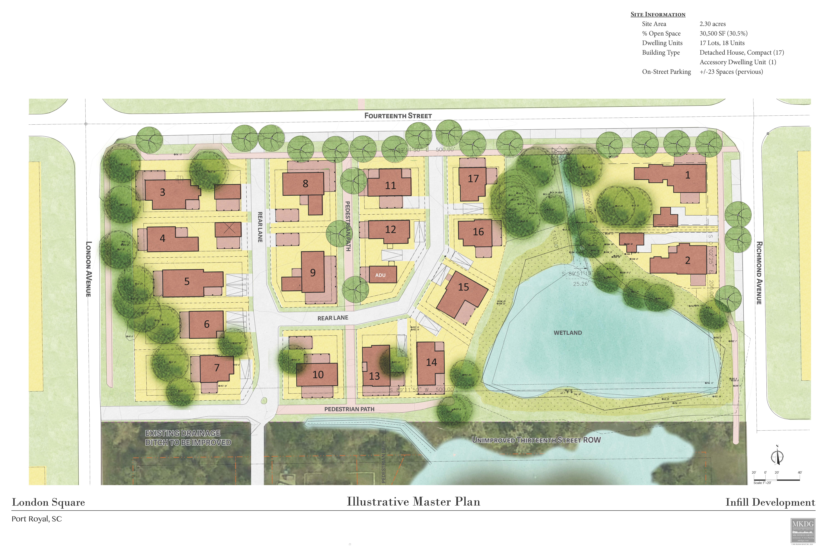

Slide 4
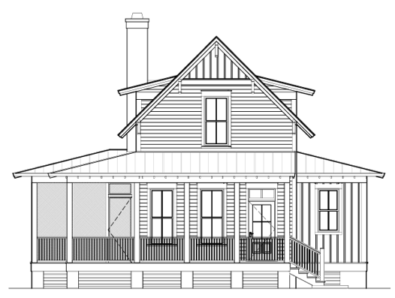
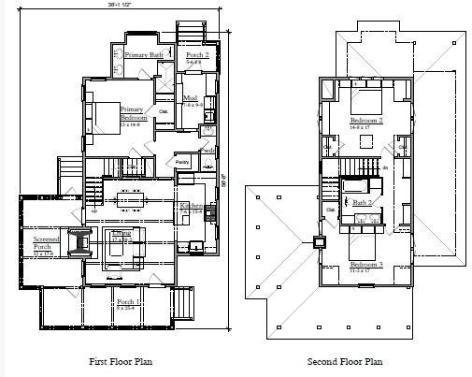
London Square - Lot 3
$895,000
3 Bedrooms 2.5 Bathrooms
Building Areas
Heated | 1761 sq ft
Total Porch | 457 sq ft
Screened | 257 sq ft
Open | 200 sq ft
Additional Specs
1 car garage with 1 car carport Natural gas fireplace on porch Natural gas fireplace in Great Room 30-year metal roof 5 V Crimp Cement board siding/trim Engineered hardwood throughout 9’ ceilings Quartz countertops Bosch appliances Kohler fixtures throughout

Slide 5
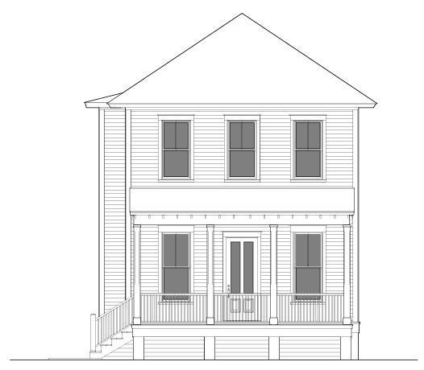
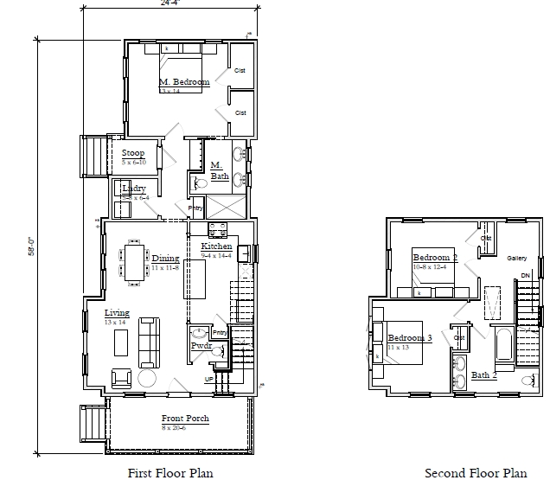
London Square - Lot 4
$832,500
3 Bedrooms 2.5 Bathrooms
Building Areas
Heated | 1523 sq ft
Total Porch | 201 sq ft
Screened | 41 sq ft
Open | 160 sq ft
Additional Specs
1 car garage with 1 car carport Cement board siding/trim 30-year metal roof 5 V Crimp Engineered hardwood throughout 10’ ceilings Quartz countertops Bosch appliances Kohler fixtures throughout

Slide 6
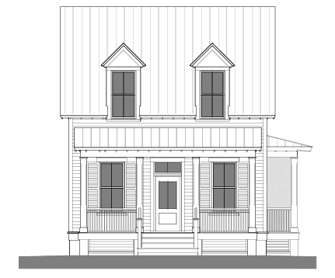
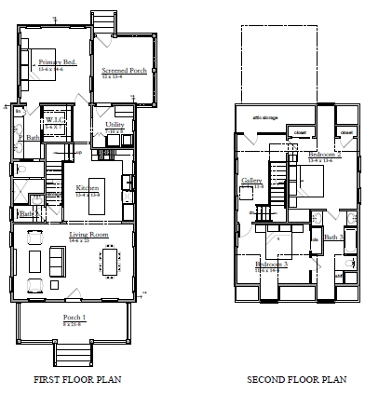
London Square - Lot 5
$887,500
3 Bedrooms 2.5 Bathrooms
Building Areas
Heated | 1799 sq ft
Total Porch | 333 sq ft
Screened | 141 sq ft
Open | 192 sq ft
Additional Specs
Cement board siding/trim 30-year metal roof 5 V Crimp Engineered hardwood throughout 10’ ceilings Quartz countertops Bosch appliances Kohler fixtures throughout

Slide 7
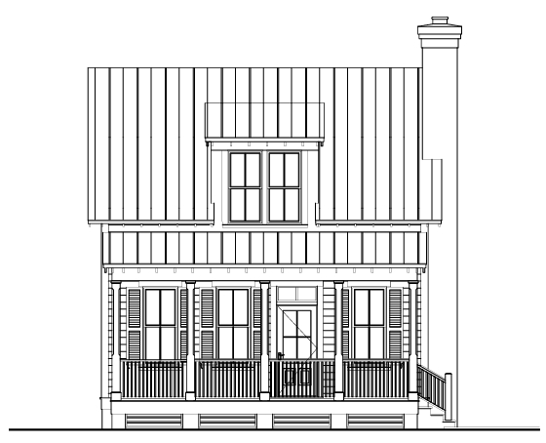
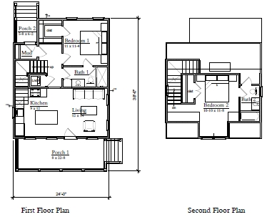
London Square - Lot 6
$589,000
2 Bedrooms 2 Bathrooms
Building Areas
Heated | 977 sq ft
Total Porch | 216 sq ft
Screened | 24 sq ft
Open | 192 sq ft
Additional Specs
Golf cart port Cement board siding/trim 30-year metal roof 5 V Crimp Engineered hardwood throughout 9’ ceilings Quartz countertops Bosch appliances Kohler fixtures throughout

Slide 8
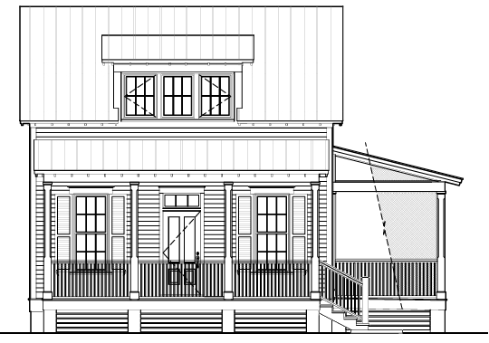
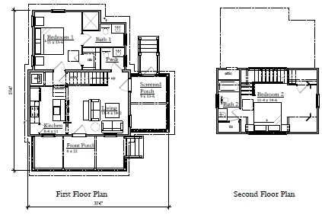
London Square - Lot 7
$599,000
2 Bedrooms 2.5 Bathrooms
Building Areas
Heated | 965 sq ft
Total Porch | 298 sq ft
Screened | 98 sq ft
Open | 200 sq ft
Additional Specs
Golf cart port Cement board siding/trim 30-year metal roof 5 V Crimp Engineered hardwood throughout 9’ ceilings Quartz countertops Bosch appliances Kohler fixtures throughout

